Slide 1
Contact Manager
Group 18
Notes:
Title page -- what is the project about?
Team members and what part they played
Technology used (database, frameworks, github, discord, etc)
Things that went well
Things that did not go well
Gantt chart
ERD
API demonstration
App demonstration
Time for Questions

Slide 2
Meet the Team!
Notes:
all members must speak at presentation - assign slides to members?

Slide 3
Team Members
Joshua Bell
Matthew Daley
Edrienne Gregana
Evan Naderi
Evan Tieu
API
API — Project Manager
Front-end
Front-end
Database
Notes:
explain the technology used and its role in our project

Slide 4
A Deep Dive...
Into Our Project
Notes:
all members must speak at presentation - assign slides to members?

Slide 5
Technology Used
Database — Digital Ocean
Frameworks — LAMP Stack, Bootstrap
Team Dynamics — Github & Discord
API — Postman & SwaggerHub
DNS — GoDaddy
Notes:
explain the technology used and its role in our project

Slide 6
How well did the project go?!
Some good things...
a
b
c
Some bad things...
a
b
c

Slide 7
Diagrams
Notes:
all members must speak at presentation - assign slides to members?

Slide 8
Gantt Chart

Slide 9
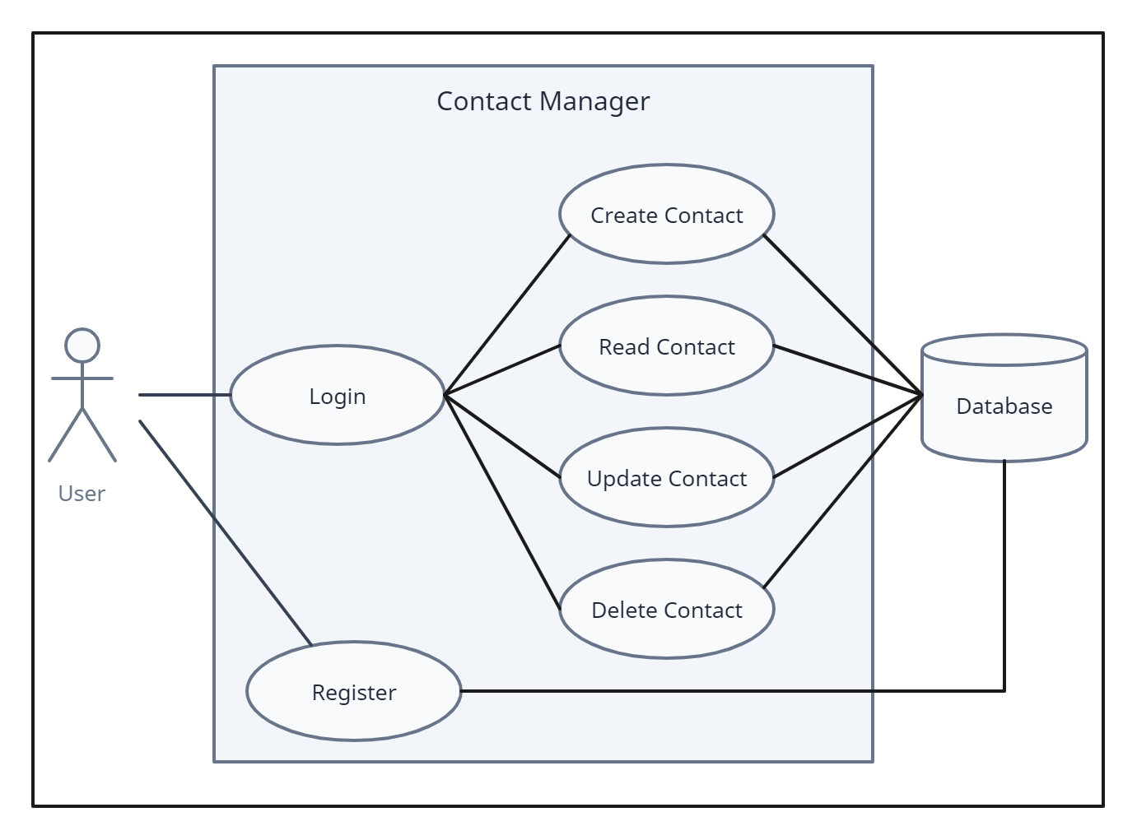
Use Case
Diagram

Slide 10
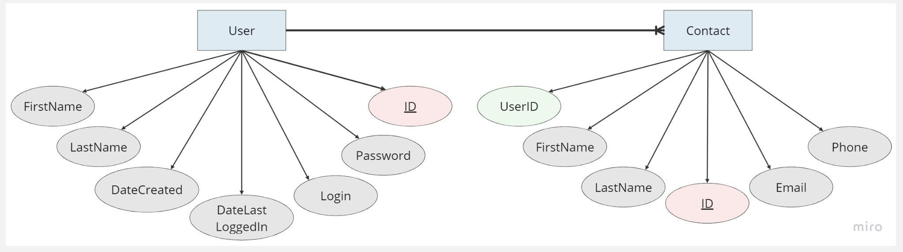
Entity Relationship Diagram
Notes:
show user and contacts - explain relationship between user and contact - explain attributes of each entity - show primary key - show foreign key

Slide 11
Color Palette

Slide 12
Demonstrations
Notes:
all members must speak at presentation - assign slides to members?

Slide 13
API
API Endpoints Demo

Slide 14
Website
http://poosd-project.com/

Slide 15
Questions? :D

